Slide 1
Capstone 12/13
Final Report
Xinran Chen, Tianyu Han, Ying Hong,
Siyu Shen, Shiyuan Xu
From Columbia MS Data Science

Slide 2
Objective
Walk through of the ML process
Image classification result analysis
Further proposal on the dataset

Slide 3
ML Data Acquisition
All numerical data came from the NHANES dataset:
Download the data from the website in XPT format
Upload the data into a common platform (google drive) for multi-access
Load/read data in python language for preprocessing

Slide 4
Data Engineering
Label the target feature (psoriasis)
Select 35+ features from hundreds of features from the data set
Encode string features
Impute missing values
Data Augmentation

Slide 5
Model Selection
Logistic Regression
XGboost
Fandom Forest
SVM
CNN

Slide 6
Selected Feature Importance Report
- Random Forest & SVM
Most Important Features:
BMXHT: Standing Height (cm)
RIDAGEEX: Exam Age in Months
BMXBMI: Body Mass Index (kg/m**2)
LBDVIDMS: Vitamin D (nmol/L)
RIAGENDR: Gender
SMQ020: Smoked at least 100 cigarettes in life
DEQ038G: In the past yr did you have sunburn?
ALQ150: Ever have 5 or more drinks every day?

Slide 7
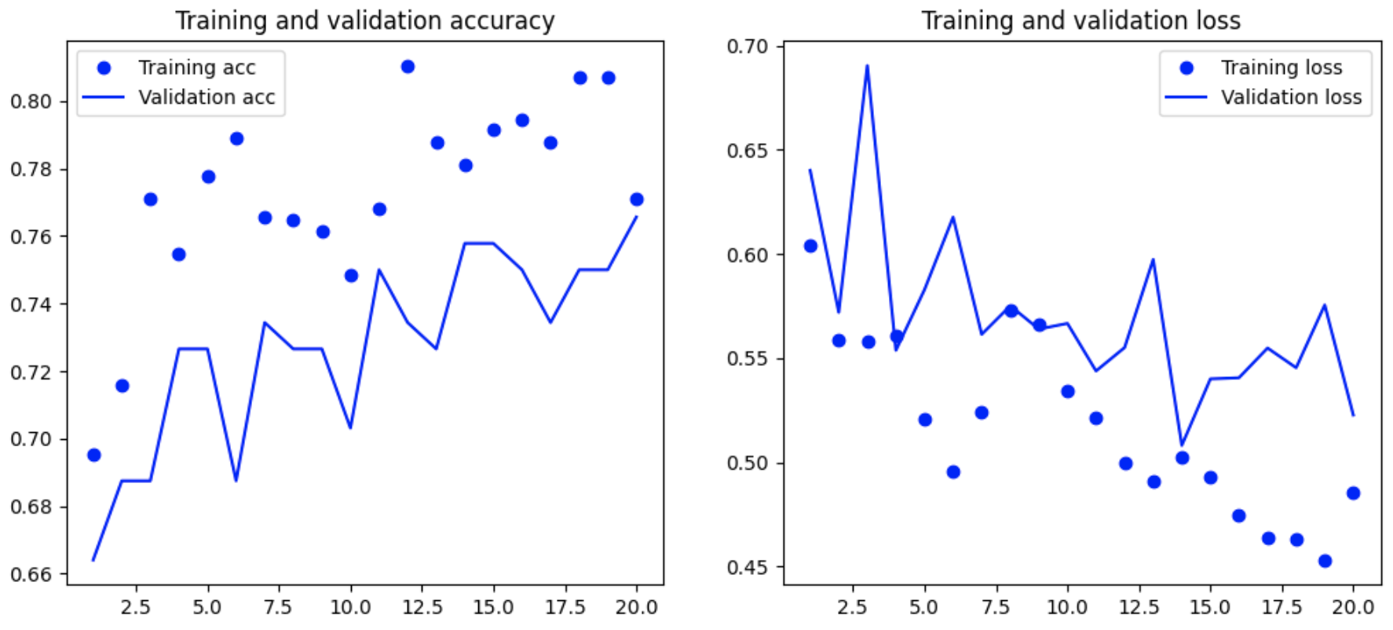
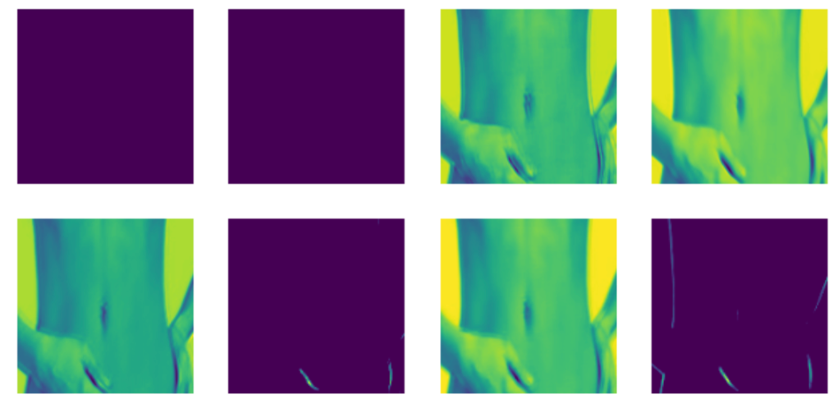
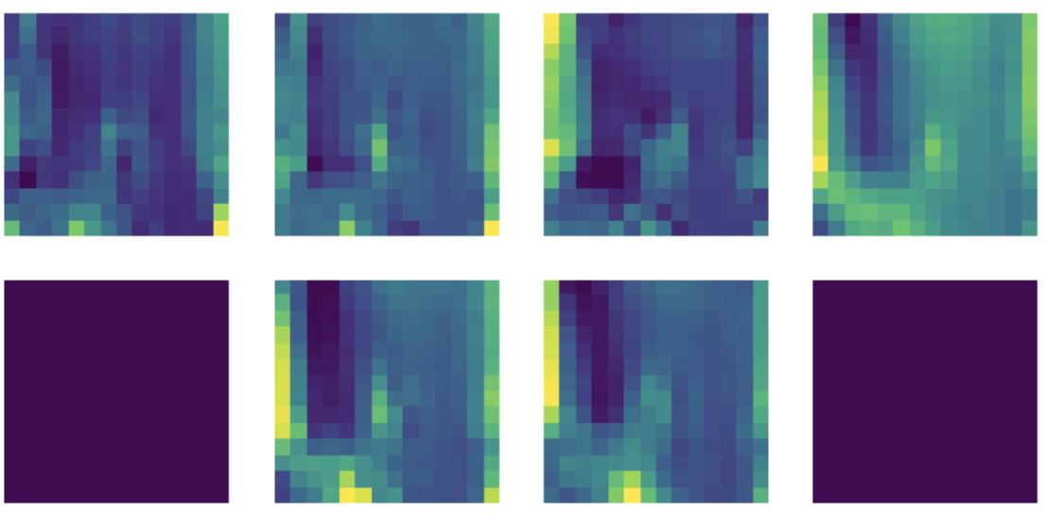
Image Classifier Report
800 total images (augmented from 200) healthy vs psoriasis
6 layer deep learning structure (4 CNN + 2 dense)
Achieves around 75% after tuning

Slide 8
Potential next stage proposal on the NHANES dataset
Similar process can be done on other health conditions like sunburn, micronutrient deficiency, etc.
Statistical modeling on the database itself (racial, gender, geographical breakdown).
Laboratory data vs self-report data analysis.

